Slide 1

NJ 50X30 Building Electrification Webinar
Complications in Townhouses
Robert Morrow
Retired history professor
Member of Citizens Climate Lobby

Slide 2
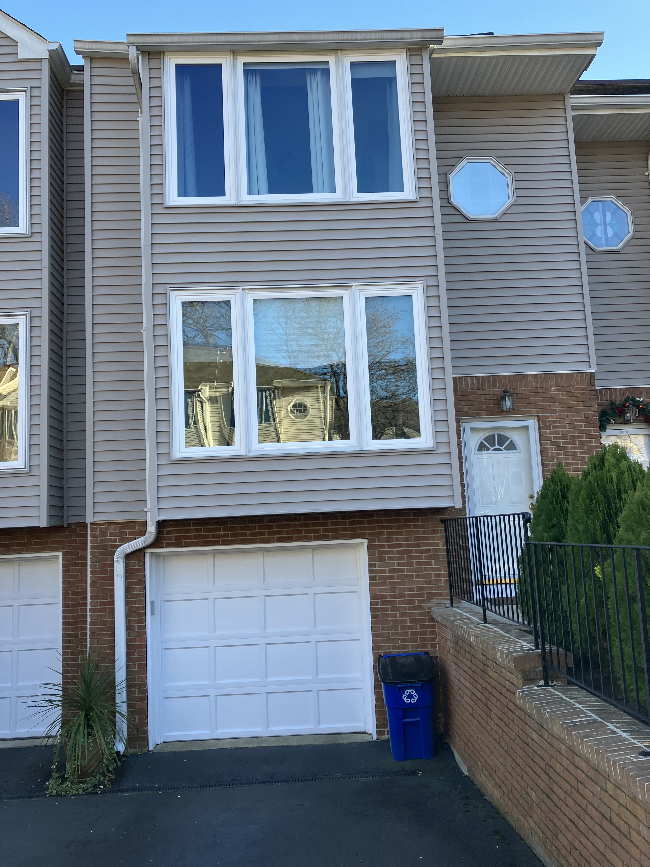
Our House
Purchased last spring
Hoped to create a model electrified home
Elkridge in Red Bank
Condominium townhouses

Slide 3
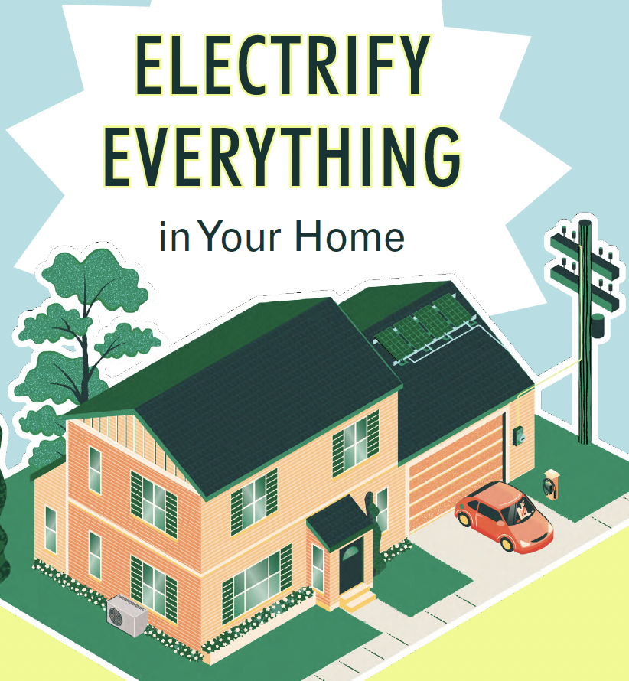
Overview of my remarks
First steps: EV, electric panel,
car charger
A tight envelope: insulation,
new window
Heat pumps

Slide 4
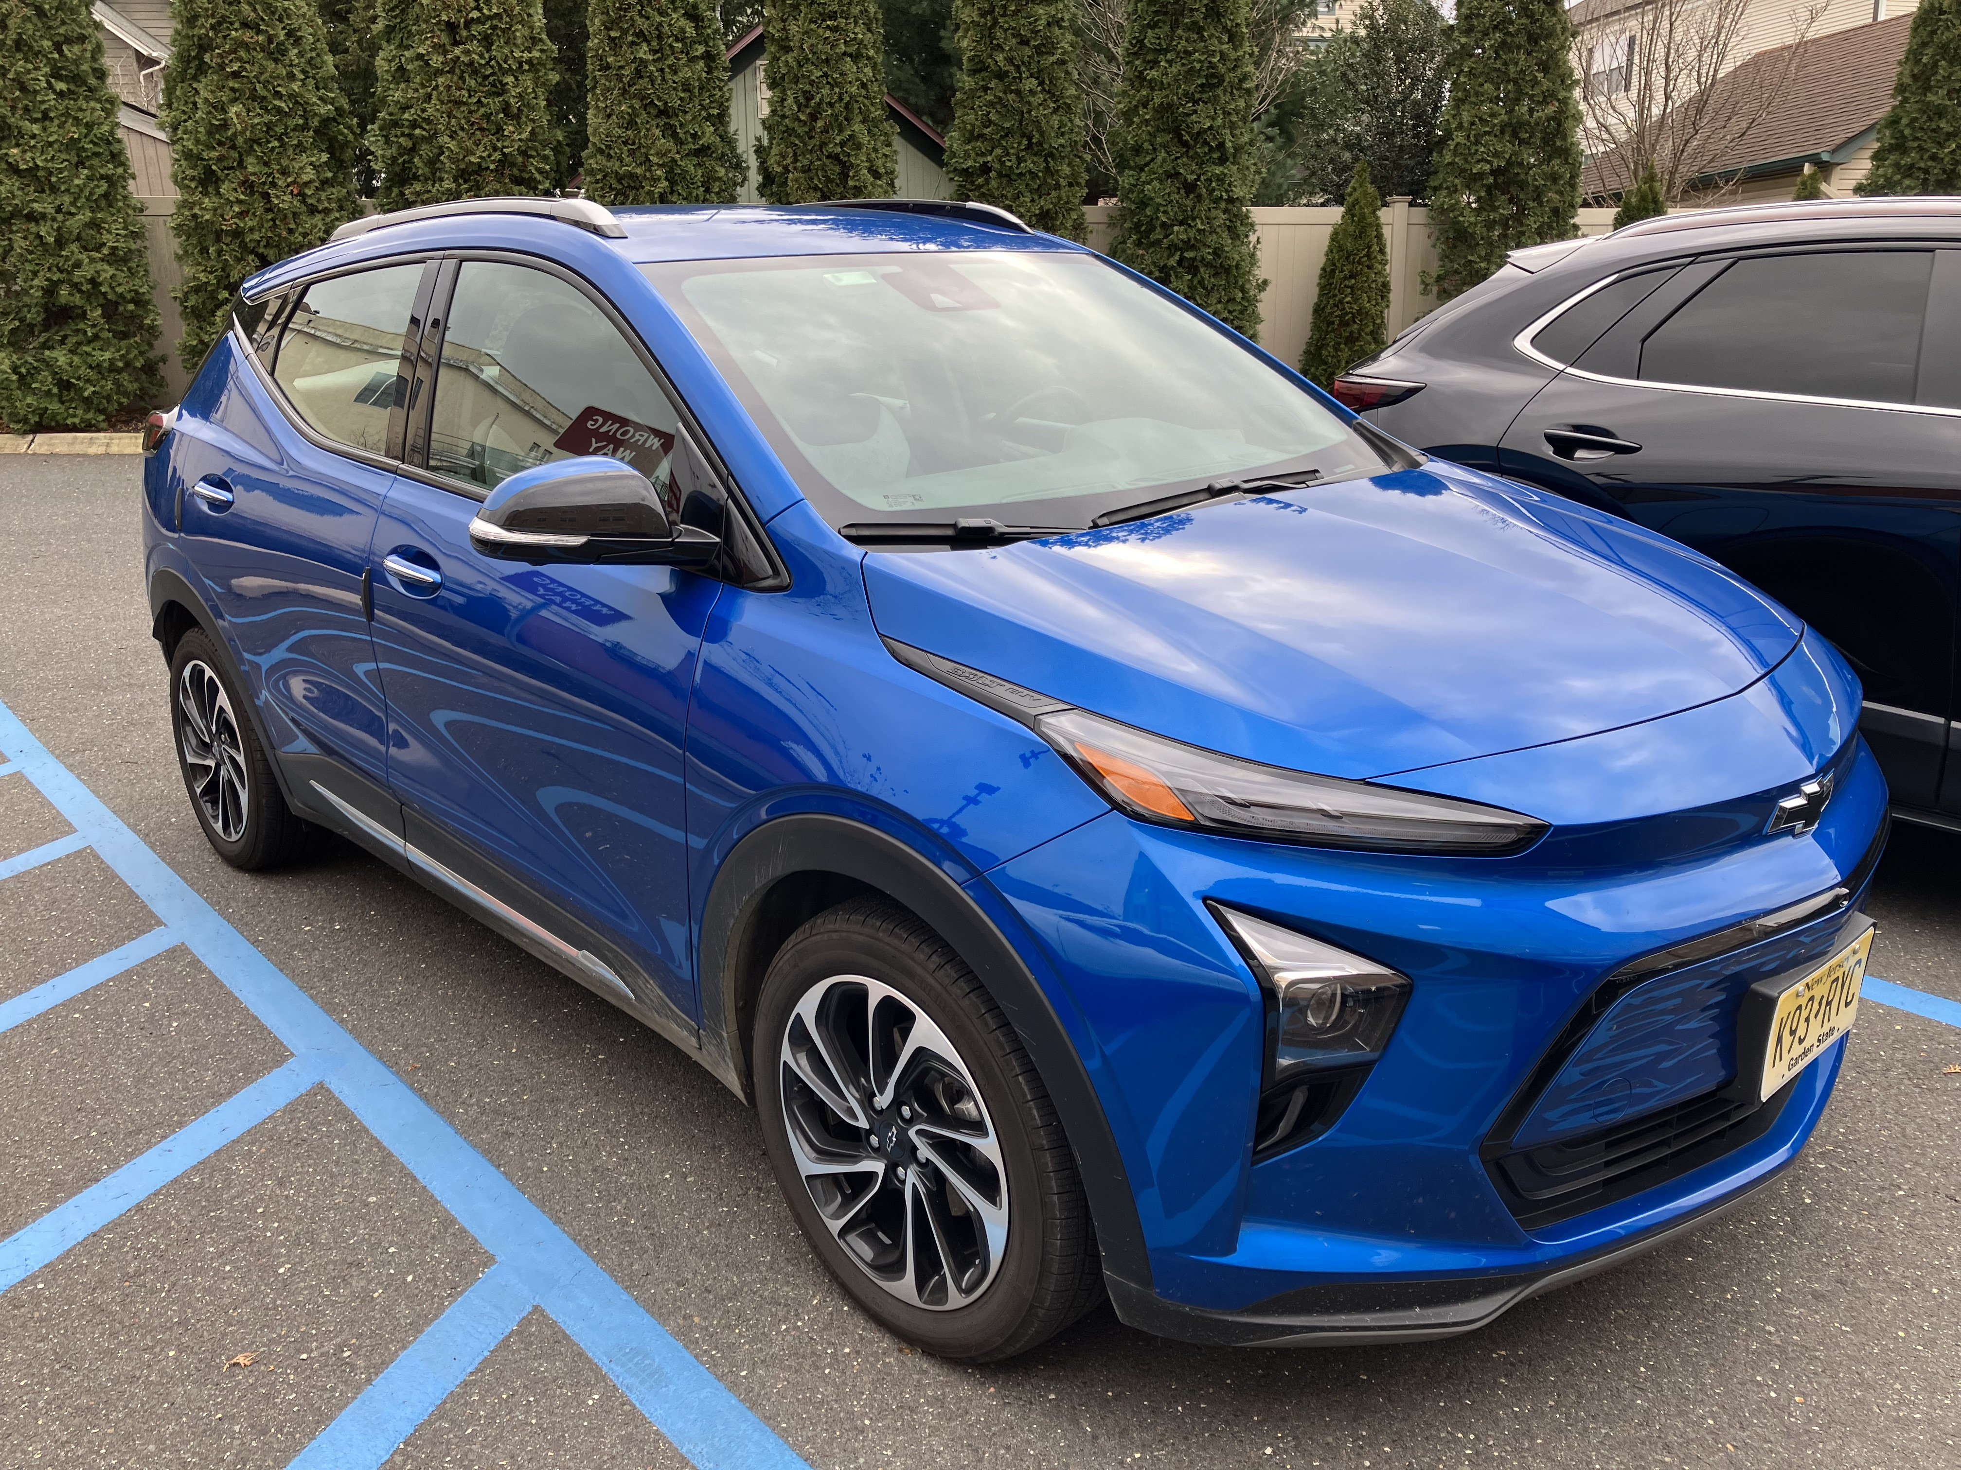
First Steps
EV: 2023 Chevrolet Bolt EUV
  New electric panel and EV charger
    Lesson: charge at home => forget
    range anxiety
    Needed 200 amps, but couldn’t get it
  Problems of condo electric lines

Slide 5
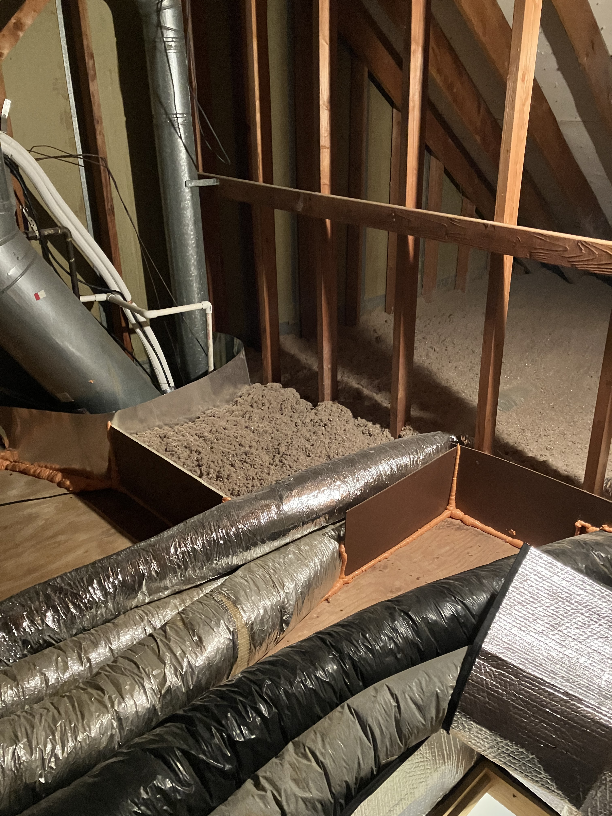
A Tight Envelope
Start with home energy audit
Windows even before the audit
Attic insulation and foundation
sealing
Result: subtle, no drafts
  Post test showed substantial improvement

Slide 6
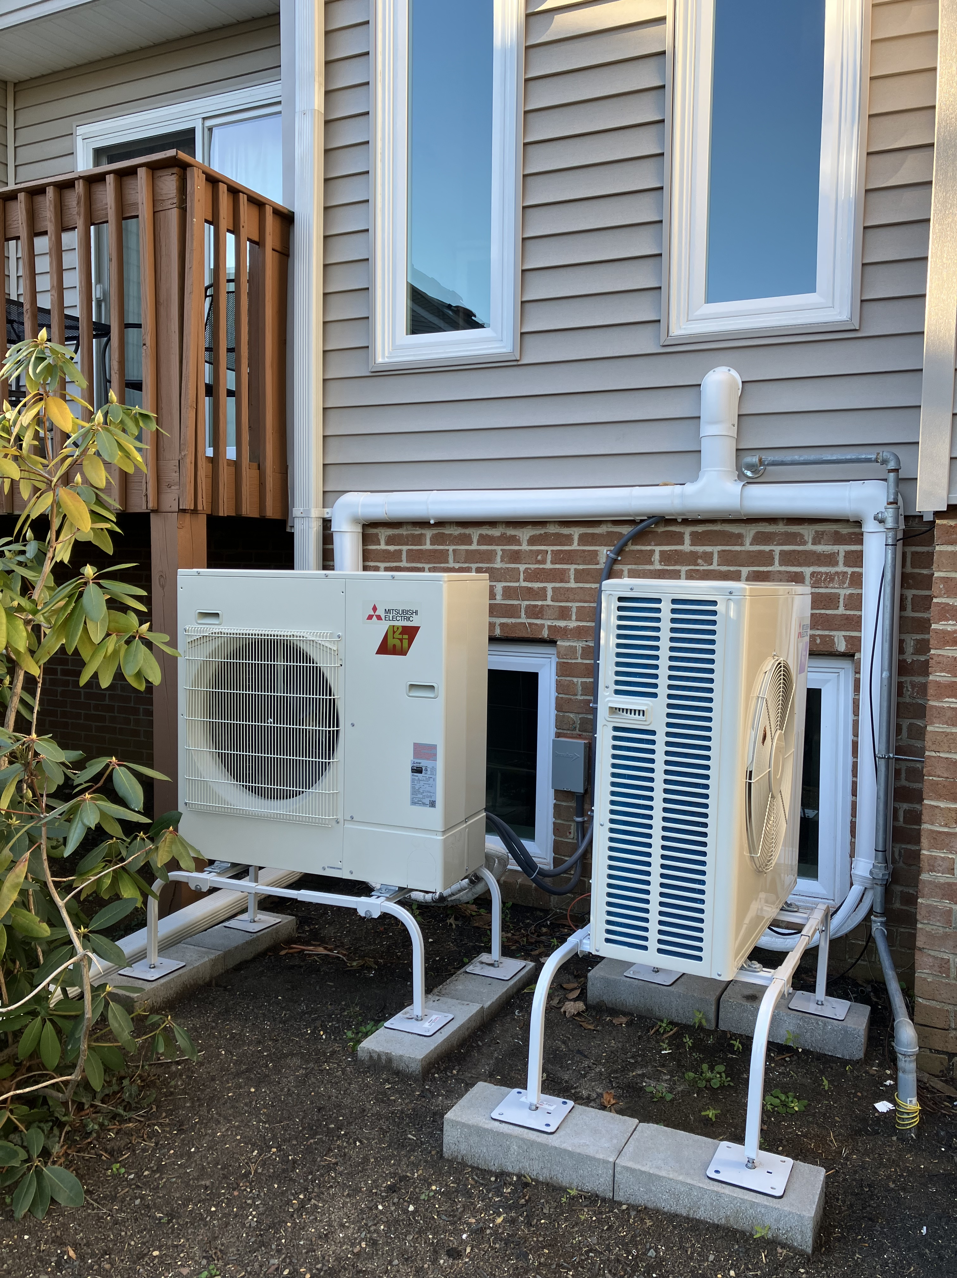
Heat Pumps: Getting Quotes
Townhouse on 3 floors—two zone
HVAC system
Got quotes from 5 contractors
I insisted on a heat pumps only system
Only Arctic Air in Old Bridge did not
advise against it
Sales rep proposed Mitsubishi ducted heat pumps

Slide 7
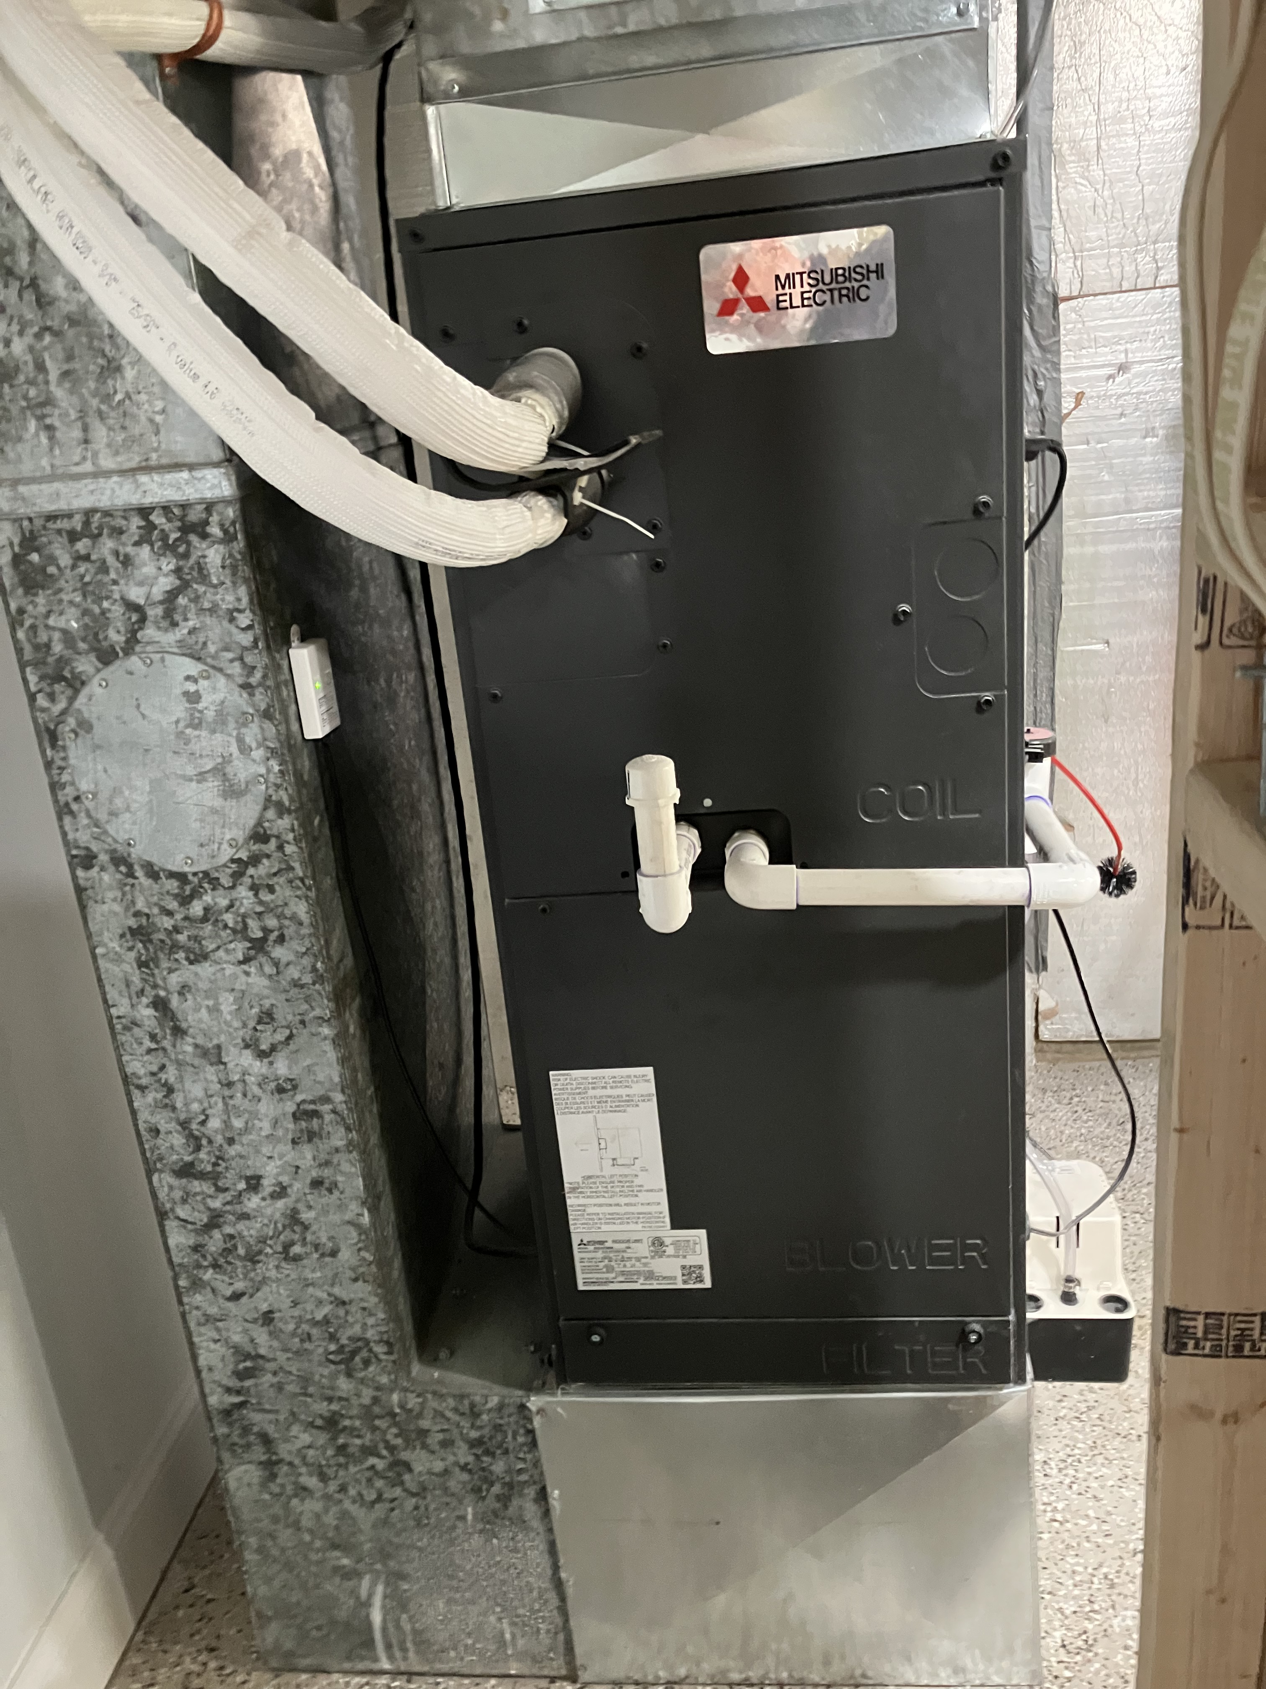
Heat Pumps: Installation
Installation of 2 condensers, 2 air
handlers
1 air handler had defective part
Also installed a Load Control Module
0% 10-year loan from National
Energy Improvement Fund

Slide 8
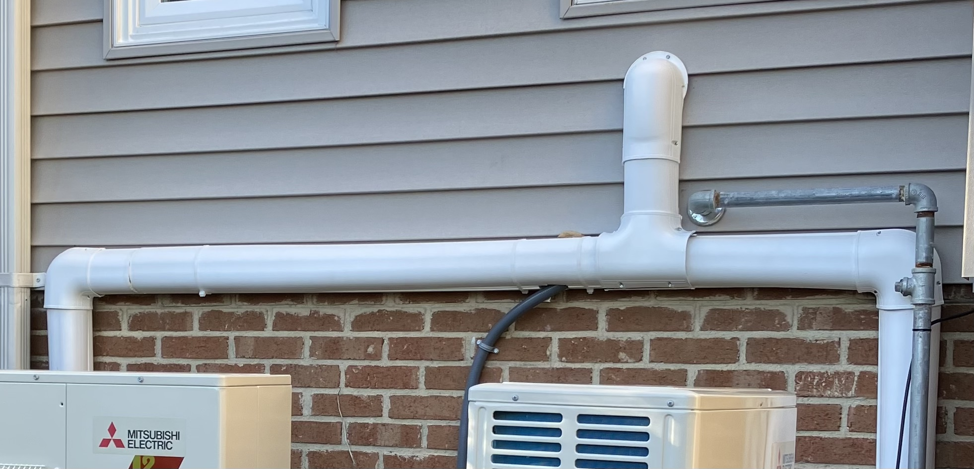
Heat Pumps: Big Problem with HoA
Refrigerant lines couldn’t follow gas lines
Installers drilled through wall, covered exterior lines

Slide 9
Heat Pumps: Big Problem with HoA
HoA Property Manager was shocked & furious
Board ordered:
  Exterior line covers painted
  Plantings to screen off condensers from public view

Slide 10
Lessons for Condominiums
Contractor must carefully consider the architecture of the home before bidding and installing
Problems of electrical supply can be unexpected
Perhaps, additional subsidies from the federal or state governments will be necessary to help out condominium homeowners
… and remember to consult the experts, like the Millers

